Slide 1

Airbnb Market Intelligence
Optimizing Pricing and Host Performance for Success
Ansh Pratap Singh INTERNSHIP_17546440516895be537820f

Slide 2

PROBLEM STATEMENT
Airbnb hosts and stakeholders lack integrated, data-driven insights necessary to optimize their listings and maximize revenue and performance in a competitive market.
The challenge is to identify and quantify the complex interrelationships between booking patterns (temporal and location-based), effective pricing strategies, evolving guest preferences (room type and ratings), and measurable host performance metrics (responsiveness and activity levels).

Slide 3
Project Overview:
This project is a comprehensive Jupyter Notebook-based data analysis application designed to extract actionable insights from over 100,000 Airbnb listings. The core objective is to move beyond simple descriptive statistics to understand the underlying drivers of success for Airbnb hosts. By systematically analyzing the relationships between booking patterns, pricing, guest behavior, and host performance, this project provides a data-driven framework for strategic decision-making in the competitive short-term rental market.
Analysis Modules and Key Visualizations:
Module | Purpose | Key Visualization & Techniques
1. Pricing Strategies | Determines optimal pricing by location and seasonality. | Custom Box Plots (capped at the 99th percentile for outlier visibility), Histograms, and Correlation Scatter Plots.
2. Booking Patterns | Identifies peak booking times and high-demand locations. | Time Series Plots for monthly trends and Bar Charts for top-performing neighborhoods.
3. Guest Preferences | Uncovers demand for specific room types and quality expectations. | Proportional Pie Charts, Bar Charts for room type distribution, and segmented rating analysis.
4. Host Performance | Evaluates operational efficiency and service quality. | Distribution analysis of host responsiveness, acceptance rates, and Reviews Per Month using a customized Seaborn Boxplot with a logarithmic or percentile-capped axis to handle skewed data.

Slide 4
The end users of this Airbnb Market Intelligence project are primarily individuals and organizations directly involved in the short-term rental ecosystem who need data-driven strategies to improve performance, pricing, and operational efficiency.
Key End Users
1. Airbnb Hosts (The Primary Audience)
Goal: Maximize occupancy, revenue (yield), and guest satisfaction ratings.
Use of the Project: They use the analysis to make direct business decisions:
  Pricing: Determine the optimal price based on seasonality and neighborhood competition (from the Pricing Strategies module).
  Operations: Identify the required host activity level and responsiveness benchmarks for top performance (from the Host Performance module).
  Listing Strategy: Understand which Room Types are in highest demand and how guest preferences are changing (from the Guest Preferences module).
2. Property Managers and Real Estate Investors
Goal: Evaluate potential investment properties, set portfolio-wide pricing rules, and benchmark performance across multiple markets.
Use of the Project: They utilize the Booking Patterns module to:
  Assess the profitability and seasonality risk of a specific location before investing.
  Compare performance metrics (average price, reviews per month) of their managed properties against the market benchmarks.
3. Airbnb Company/Platform Stakeholders
Goal: Understand market health, identify popular features or locations for marketing campaigns, and improve host support.
Use of the Project: They can use the aggregated data on Guest Preferences and Booking Patterns to:
  Tailor marketing efforts to high-demand periods or emerging locations.
  Develop educational materials for hosts based on the Host Performance analysis (e.g., best practices for response rate).
4. Data Analysts and Scientists (Academic/Portfolio)
Goal: Demonstrate technical skills in data cleaning, feature engineering, statistical analysis, and data visualization.
Use of the Project: While not using the insights for business gain, they serve as the technical audience who will review the project's code quality, architectural design, and methodology (e.g., robust column detection, percentile-based visualization)

Slide 5

Technology Used
Core Python Libraries (Analysis & Data Handling)
pandas: Primary library for Data Manipulation, Cleaning, and Transformation. Used for reading the Excel file, handling missing values, and engineering new features.
numpy: Utilized for Efficient Numerical Operations and array processing.
datetime: Crucial for all Temporal Data Handling, including parsing date columns, calculating time differences, and analyzing seasonality.
openpyxl: The specific engine required by pandas to successfully Read Data from the .xlsx file format.
Visualization Libraries
matplotlib: Provides the Base Plotting functionality and low-level control for creating and customizing all charts (Histograms, Box Plots, etc.).
seaborn: Used extensively for Advanced Statistical Visualization. It delivers aesthetically pleasing and highly informative charts like the styled Box Plots and Bar Charts, often used for clearer analysis than default matplotlib.
Environment
Python 3.11: The Programming Language used for the entire project.
Jupyter Notebook: The Interactive Development and Presentation Environment where the code runs, visualizations are displayed, and documentation resides (airbnb_analysis.ipynb).

Slide 6
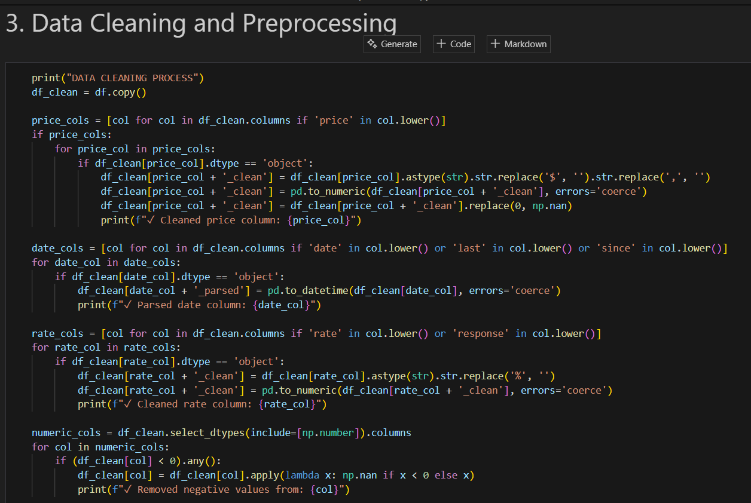
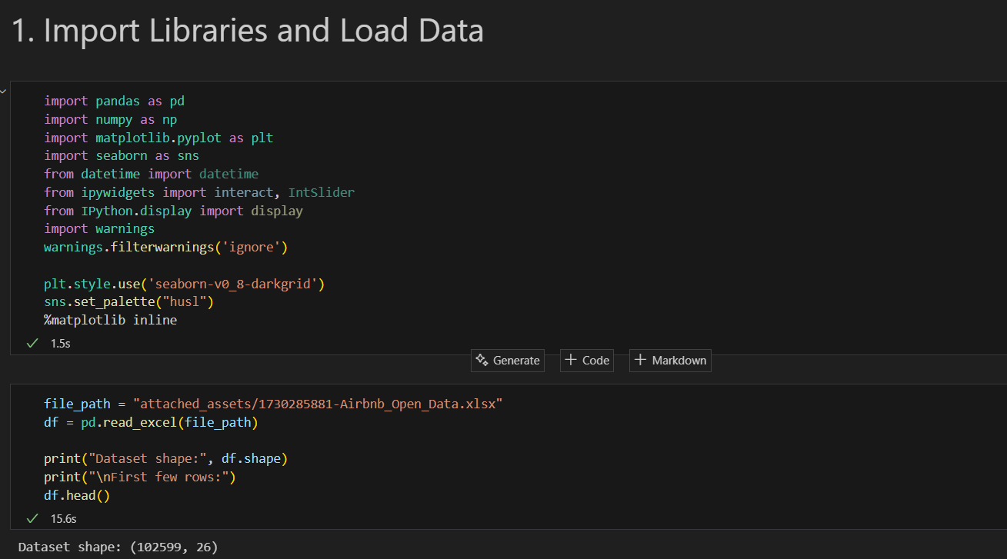
RESULTS1

Slide 7
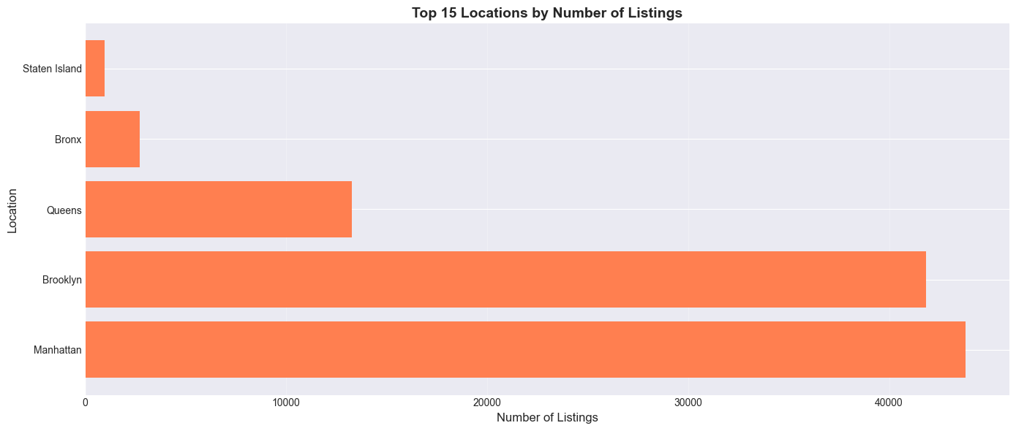
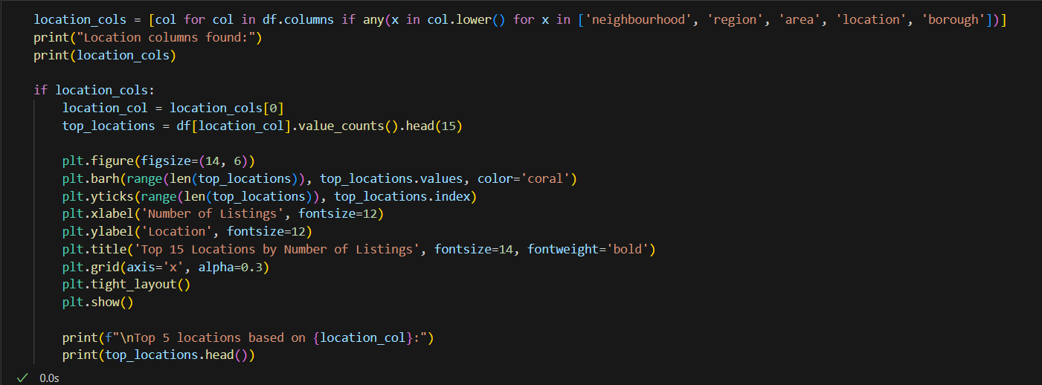
RESULTS2

Slide 8
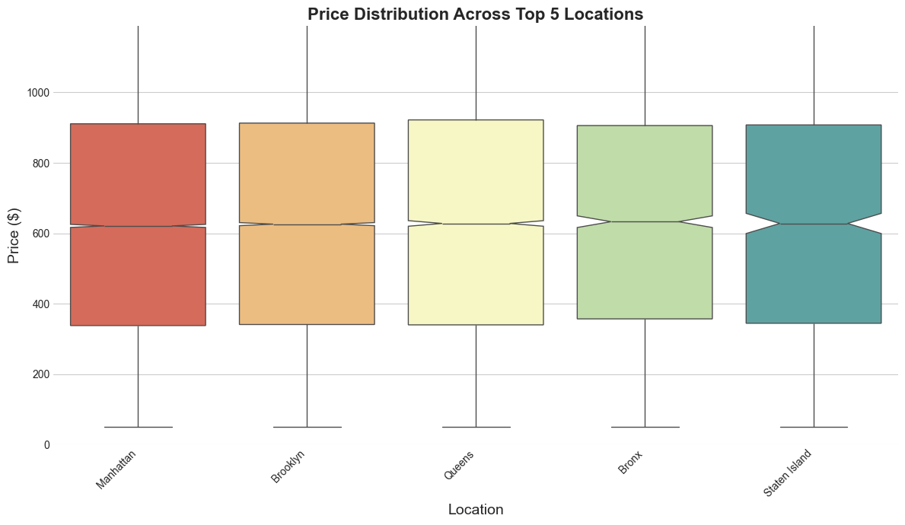
RESULTS3

Slide 9
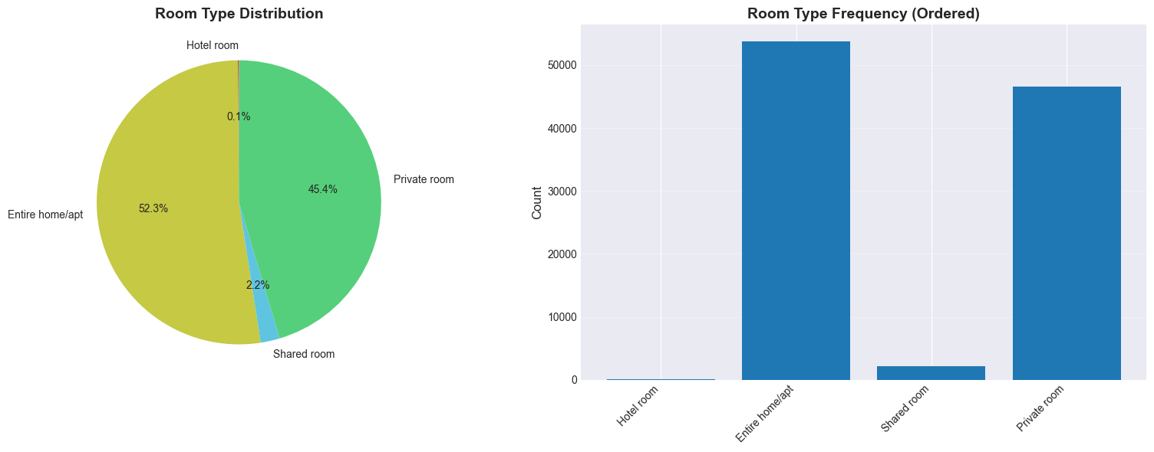
RESULTS4

Slide 10
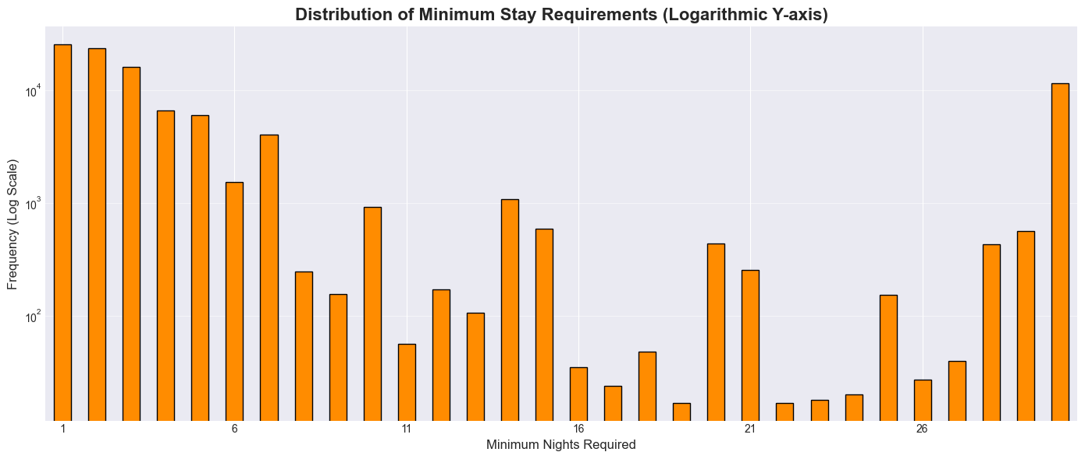
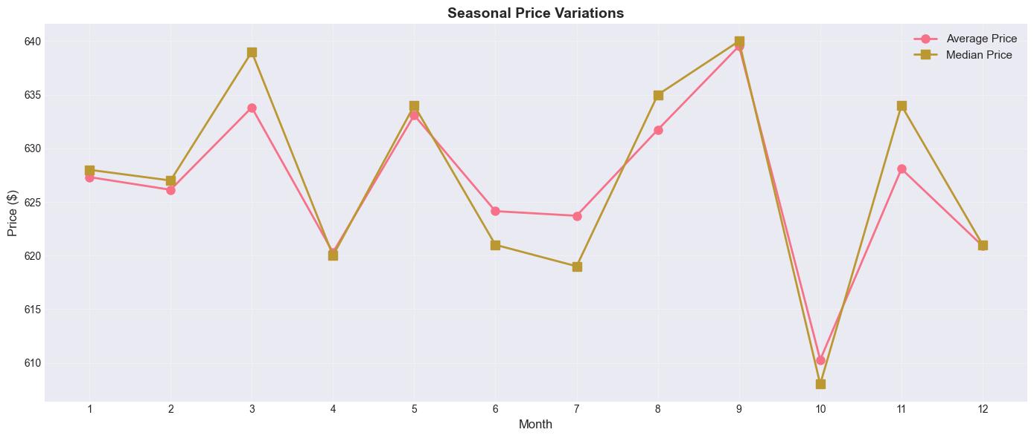
RESULTS5

Slide 11
GitHub repository
GitHub Repository Link: https://github.com/Ansh07017/VOIS_AICTE_Oct2025_AnshPratapSingh

Slide 12
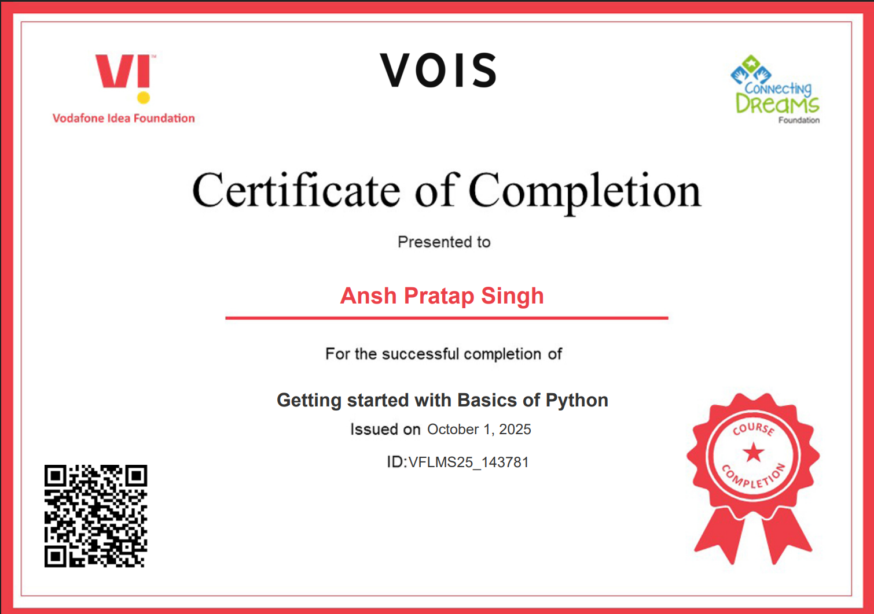
Getting started with Basics of Python Certificate

Slide 13
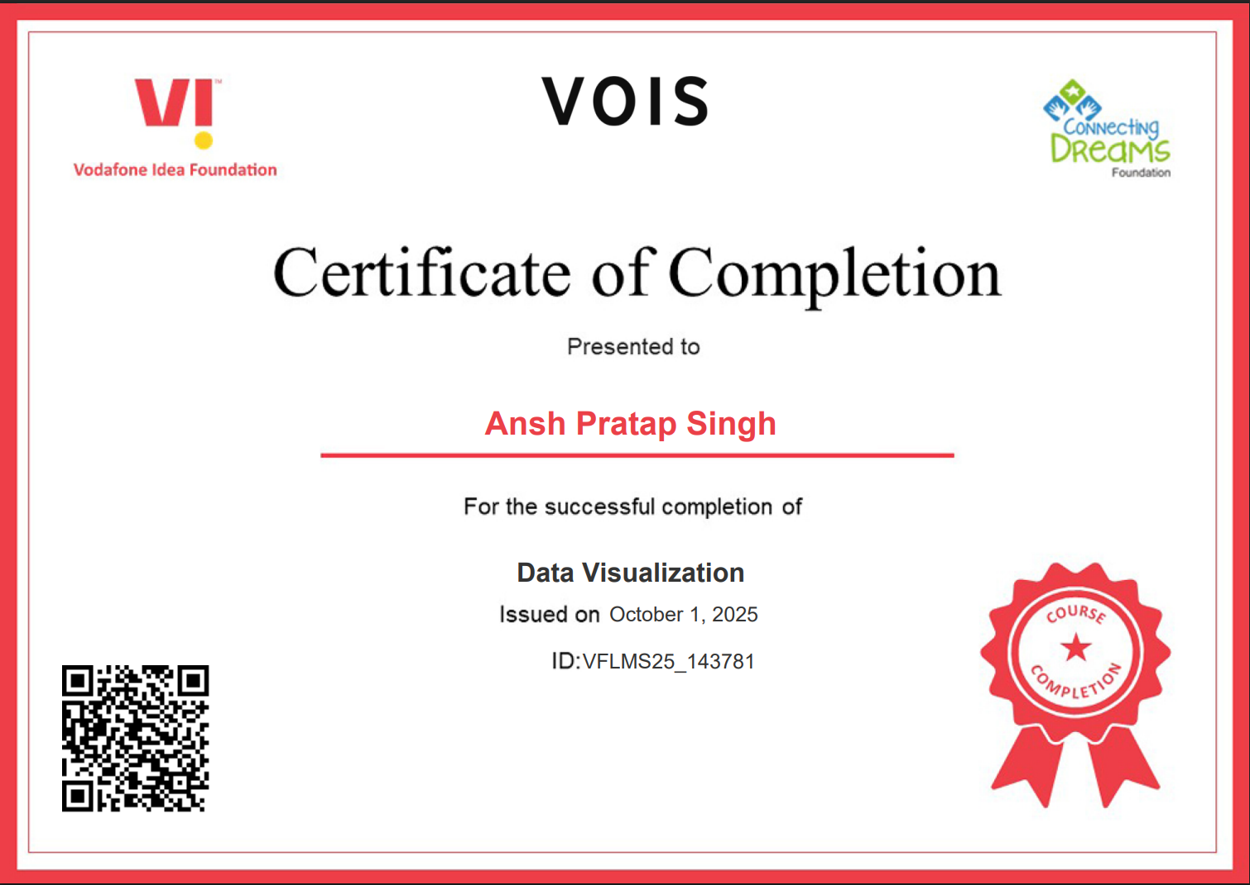
Data Visualization Certificate

Slide 14
Thank you
I'm genuinely thankful for the opportunity to have worked on this challenging and insightful Airbnb project. It provided a perfect platform to combine strong data analysis with direct, actionable business strategy.
- Ansh Pratap Singh
.
.

